Slide 1
HR ANALYTICS
Employee Retention
Presented by Group - 1
kumari neelaveni
Lakshmi Vijay
Jyothi Mahantesh Sondur
Akshata Gangappa GayaKawad
Sammed Nasalapure
Bhavana.V
Ganji Hemanth Kumar

Slide 2

Agenda
Introduction
Problem Statement
Business Objective
KPIS
DashBoard
Conclusion

Slide 3


Introduction
HR analytics involves the collection and analysis o HR-related data, including employee data, performance metrics, and other relevant data points. By using advanced analytical tools and techniques, HR analytics provides valuable insigh into HR processes and trends, enabling organizations to make more informed decisions about their employees and improve overall performance.
HR analytics involves the collection and analysis of HR-related data, including employee data, performance metrics, and other relevant data points. By using advanced analytical tools and techniques, HR analytics provides valuable insights into HR processes and trends, enabling organizations to make more informed decisions about their employees and improve overall performance.

Slide 4


Problem Statement
Average attrition rate for all Departments Average hourly rate of Male Research Scientist
Attrition rate Vs Monthly Income stats
Average working years for each Department Job role Vs Work life balance
Attrition rate Vs Years Since last promotion

Slide 5


Business Objective
The aim of this project is to analyze employee retention
and attrition rates with the organization and provide insights to the HR team for developing effective retention strategies. Through data analysis and visualizations, we will identify factors that contribute to :
Employee turnover and attrition.
Evaluate the effectiveness of existing retention strategies. To verify the satisfaction level of employee in the organization.
Provide recommendations to improve employee retention.

Slide 6

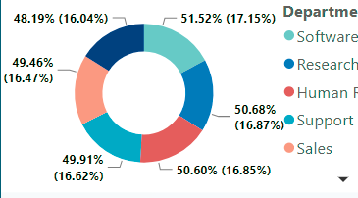
KPI - 1
Average attrition rate for all Department
Insights from KPI 1:
We can clearly say that attrition rate of employees for every department is almost 50% which indicates that attrition rate of employees does not depends on department. So, irrespective of the department almost 50% of employees are leaving the company.
From this calculation and visualization we concluded that we must make strong strategies to minimize attrition rate and improve our company’s Employee retention so that we can balance the company’s growth and right talent.

Slide 7

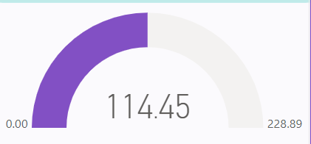
KPI - 2
Average Hourly rate of Male Research Scientist
Insights from KPI 2 :
This KPI is to find out the average hourly rate of male research scientists which is 114.45.

Slide 8

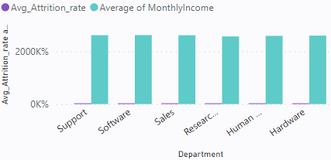
KPI - 3
Attrition Rate Vs Monthly Income Stats
Insights from KPI 3 :
Based on our analysis and visualization, it is evident that the Hardware Department has the lowest attrition rate of 49.44%, with an average monthly income of Rs.
26,091.20.
On the other hand, the Research and Development Department has the highest attrition rate of 51.21%, with an average monthly income of Rs. 26,007.08

Slide 9

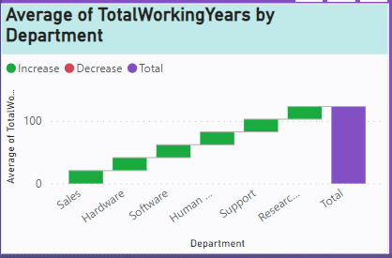
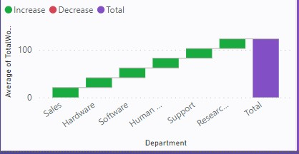
KPI - 4
Average Working Years for each Department
Insights from KPI 4:
From this we can see the average working years in software department is high as compared to the rest of the departments and lowest is for Research & Development Department.
From the analysis we can conclude that average working years is approximately 20 for all the departments.

Slide 10

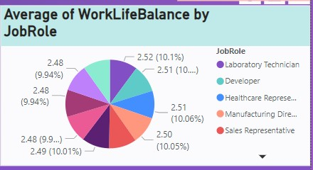
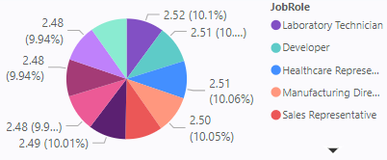
KPI - 5
Job Role Vs Work Life Balance for Total Employees
Insights from KPI 5:
From the analysis we can conclude that,
For Research directors and the
laboratory technicians the work life balance is poor.
For the Sales representatives ,
managers , Manufacturing Directors and the Sales executives the work life balance is fair.
For Research Scientists , Healthcare representatives und Developers the work life balance is good.
For human resources the work life balance is excellent.

Slide 11

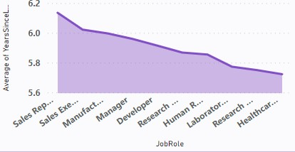
KPI - 6
Attrition Rate Vs YearsSince Last Promotion
Insights from KPI 6:
From the analysis and Visualisation
For 0-5 years since Last year Promotion interval Research & Development and Hardware departments has highest and lowest attrition rate respectively.
For 6-10 years since last year promotion interval Human
resources and software departments has highest and lowest attrition rate respectively.
For 11-15 years since last promotion interval support and
sales departments has highest and lowest attrition rate respectively.
For 16-20 years since last promotion interval software &
hardware departments has highest and lowest attrition respectively.
For 21-25 years since last promotion interval software and
support departments has highest and lowest attrition respectively.
For 26-30 years since last promotion interval support and
Human resources departments has highest and lowest attrition respectively.
For above 30 years since last promotion interval software
and Human resources departments has highest and lowest attrition respectively.

Slide 12
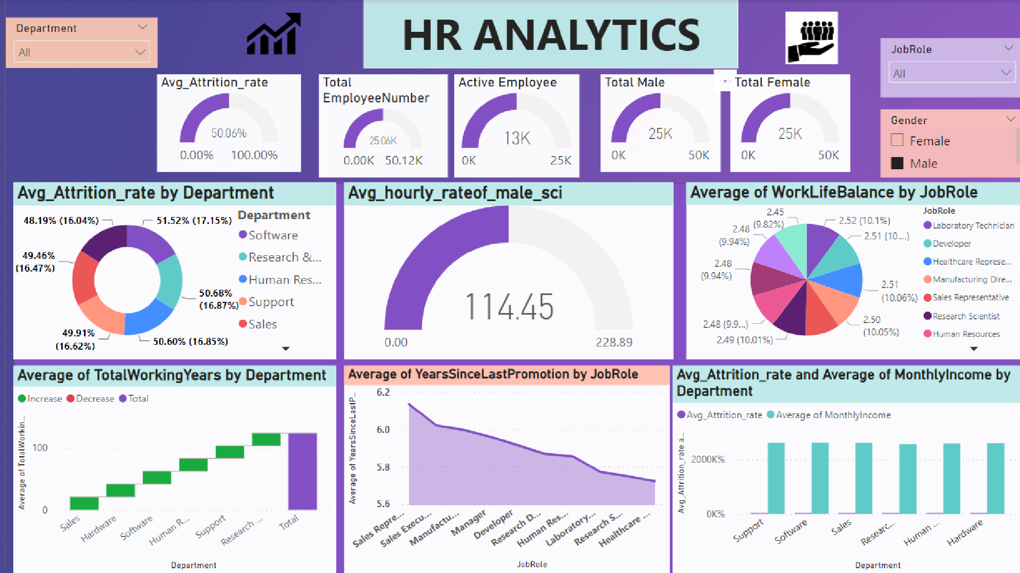

Slide 13
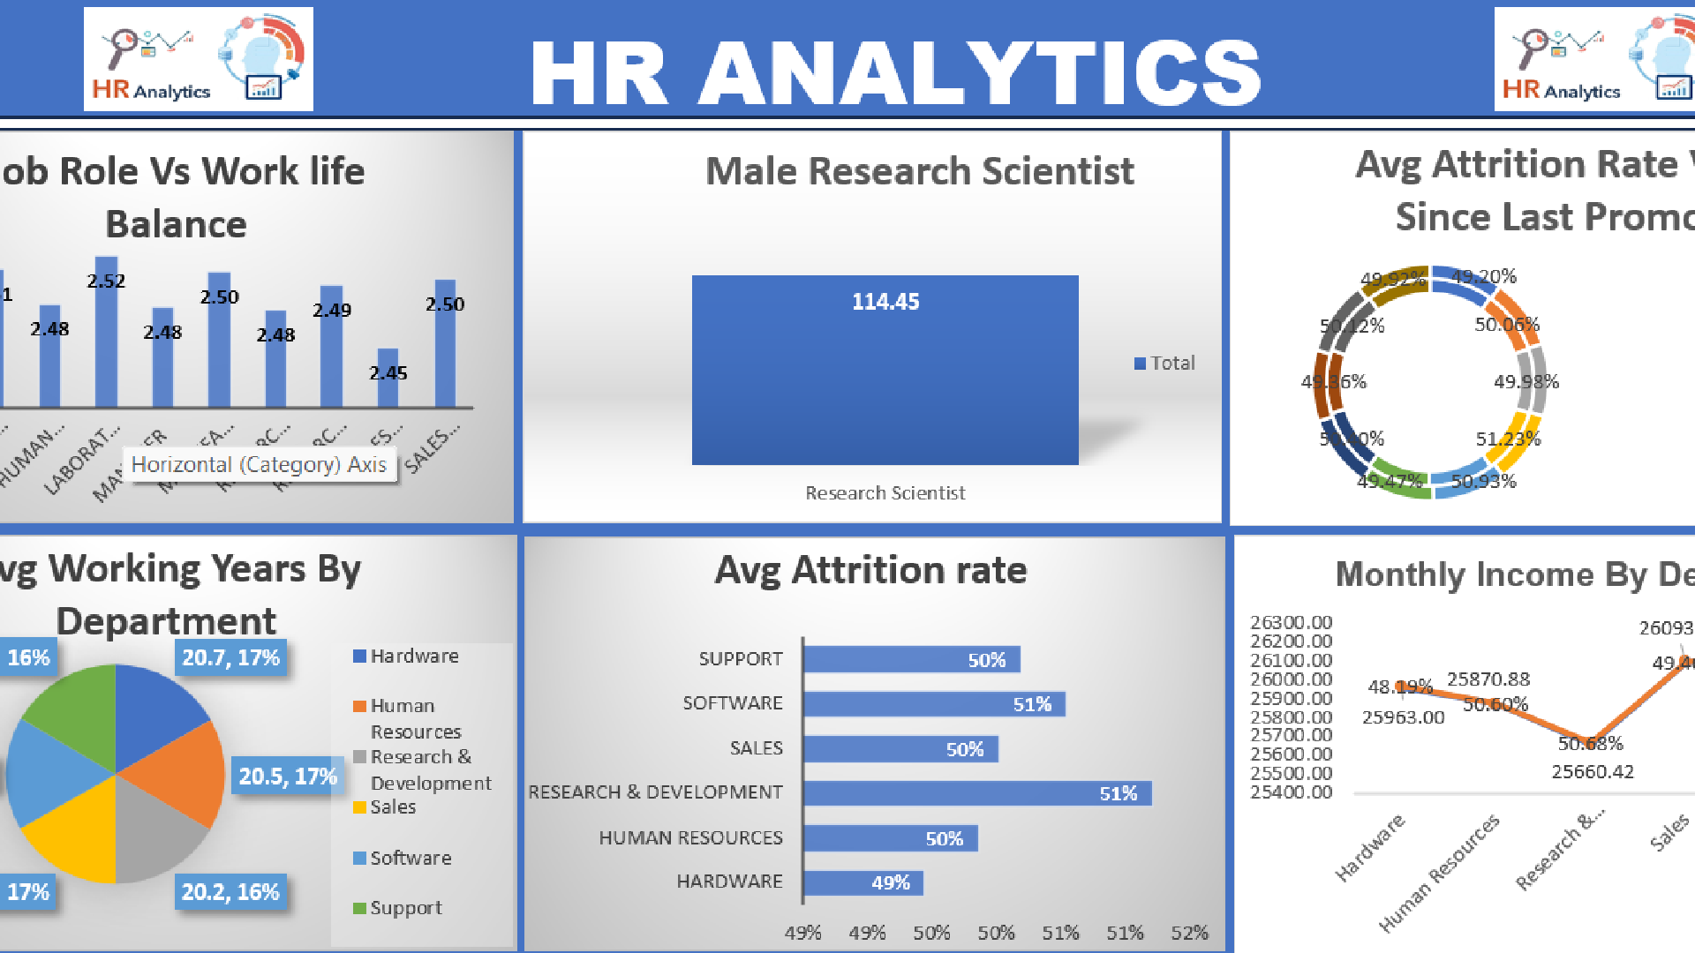

Slide 14
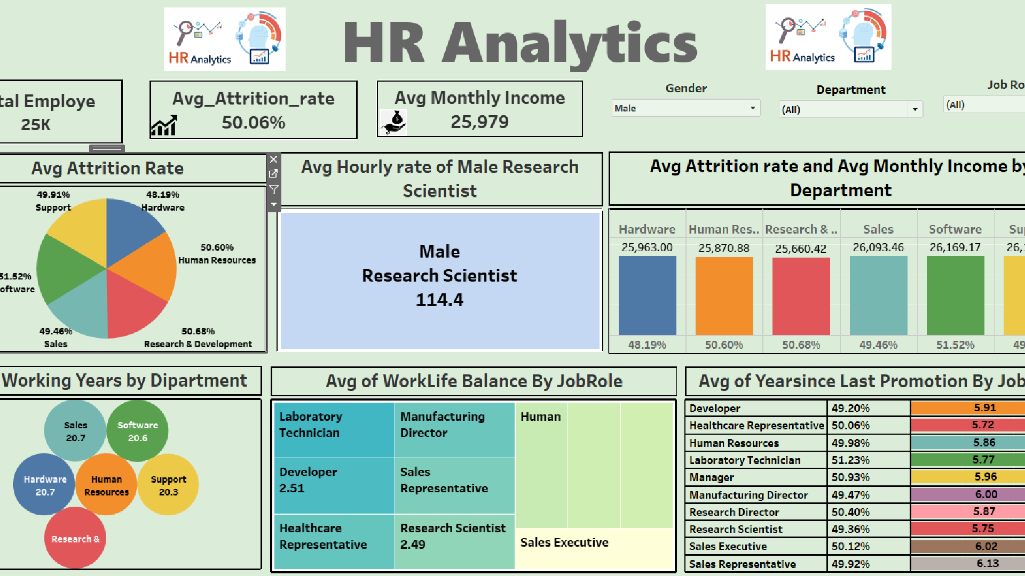

Slide 15

Conduct stay interviews: Instead of exit interviews, conduct stay interviews with employees to gather feedback about the job.
Improve employee engagement: Implement initiatives to improve employee engagement, such as regular feedback, recognition and rewards programs, and opportunities for career growth
Address workload issues: Ensure employees have manageable
workloads by regularly monitoring and adjusting workloads to prevent burnout and overwhelm.
Create a positive work environment: Foster a positive work
environment by promoting a culture of respect, inclusivity, and teamwork. Encourage open communication and collaboration among employees.
Address pay and compensation issues: Ensure that employees
receive fair pay and compensation for their work and to find out what motivates an employee to continue to work in an organization.

Slide 16


